Slide 1
P-value Definition
P-value = Probability of getting a sample statistic assuming that the null hypothesis is true
So, if we take a sample and calculate its sample statistic
What is the probability of getting this statistic if we assume that our null hypothesis is true?
That is our p-value
If this p-value comes as high, it means that the results we have obtained (e.g. sample mean) seem to be matching with what the null hypothesis says
But if the p-value is low, it means that the results we have obtained (e.g. sample mean) contradict what the null hypothesis says

Slide 2
Significance Value and P-Values
Consider we have a website on which people spend 20 minutes on average
Now we enhance the website and want to check the time people spend
H0 = 20 minutes after the change, Ha >= 20 minutes after the change
Suppose we set the significance level (α) to 0.05
We measure how much time 100 people spend on the new website and calculate their mean (sample mean), and say it is 25 minutes
Calculate P-value = Probability of getting a sample of 25 minutes, assuming H0 is true, so P-value = P(Sample mean >= 25 assuming H0 is true)
Suppose we get p-value = 0.03
This means that assuming that H0 is true, P(Sample mean >=25) is 3%
But we actually have got Sample mean >= 25; so H0 must not be true
Hence, we reject H0 when p-value < α
But if the p-value is high, say 0.5, it means that assuming H0 is true, we have a 50% chance of getting this result (25 minutes), so we do not reject H0

Slide 3
Type I and II Errors
Population
Sample
So, state H0 and Ha on some population
Calculate some statistic of the sample (e.g. sample mean)
Then, P-value = P(Obtaining that statistic in the population, assuming H0 is true)
If this P-value < Some critical value (α), we reject H0 … Case 1
If this P-value >= Some critical value (α), we do not reject H0 … Case 2
Quite logical!
However, sometimes, we may be wrong in either case
If we reject H0 when H0 is true, it is Type I error (True Negative)
If we do not reject H0 when H0 is false, it is Type II error (False Positive)

Slide 4
One-Sample T-test

Slide 5
One-sample T-test
A one-sample t-test is a statistical hypothesis test used to determine if there is a significant difference between the mean of a sample and a known or hypothesized population mean
Define H₀ as Sample mean = Population mean and H_{a} as Sample mean <> Population mean
Collect data sample, calculate sample mean and sample SD
Choose significance level (generally 5%)
Calculate test statistic (t)
t = (Sample mean – Hypothesized population mean) / (Sample SD / √Sample size)

Slide 6
One-Sample T-test : Example
It is claimed that the average amount of coffee in a cup is 12 units
We collect a random sample of 20 cups and measure the amount of coffee in each cup
H0: Hypothesized Population Mean (HPM) = 12, Ha: HPM ≠ 12
Suppose for our sample, sample mean (SM) = 11.5, SD = 1.2
t = (SM - HPM) / (s / √n) = (11.5 – 12) / (1.2 / √20) = 2.08
Degrees of freedom = Sample size – 1 = 20 – 1 = 19
Look in T-table (See next slide)

Slide 7
One-Sample T-test : Example
T-table: At https://www.sjsu.edu/faculty/gerstman/StatPrimer/t-table.pdf, look for DF 19 and two-tails value of 0.05
Why 0.05? Because confidence interval is 95%, so significance level (alpha) is 0.05
Since the absolute value of our calculated t-statistic (2.08) is less than the critical t-value (2.093) for a two-tailed test we fail to reject the null hypothesis
Conclusion: We do not have enough evidence to conclude that the average amount of coffee in a medium-sized cup served by the company is different from 12 units

Slide 8
One-sample T-test: Code Example
Example: Assess whether the average sugar level in a sample of patients is significantly different from a reference value
Null Hypothesis (H₀): The average sugar level in the sample is equal to the hypothesized population mean or reference value
Alternative Hypothesis (H₁): The average sugar level in the sample is different from the hypothesized population mean

Slide 9
One Sample t-test Code
import scipy.stats as stats
# Sample sugar level data
sugar_levels = [125, 130, 118, 122, 128, 115, 130, 135, 120, 125]
# Hypothesized population mean (recommended threshold)
hypothesized_mean = 120
# Perform one-sample t-test
t_statistic, p_value = stats.ttest_1samp(sugar_levels, hypothesized_mean)
# Compare p-value to significance level (e.g., 0.05)
alpha = 0.05
if p_value < alpha:
print("Reject the null hypothesis. The average sugar level is significantly different.")
else:
print("Fail to reject the null hypothesis. No significant difference in average sugar level.")

Slide 10
One-sample T-test: Conclusion
Find critical t-value from t-table
If calculated t-statistic > critical value, reject H₀
If we reject H₀, there is a significant difference between the sample mean and the hypothesized population mean
If we fail to reject H₀, we cannot conclude that there is a significant difference between the sample mean and the hypothesized population mean

Slide 11
One-Sample T-test Python Example
C:\code\Data Analytics\one-sample-t-test.py

Slide 12
Two Sample t-Test / Independent Sample T-Test
Compare the mean of two independent groups (i.e. Samples from two different populations)
Also called Student’s T-test
H0: There is no significant difference between the means of the two groups
Ha: There is significant difference between the means of the two groups

Slide 13
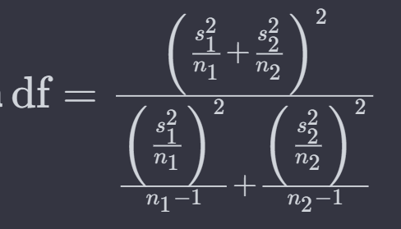
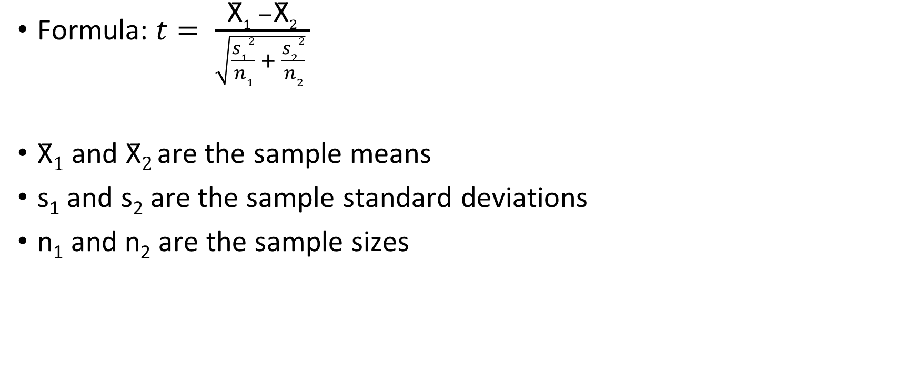
Independent Sample T-Test
Formula: $t= \frac{\text{X}\text{̄}1 −\text{X}\text{̄}2}{\sqrt{\frac{s12}{n1} + \frac{s22}{n2}} }$
$\text{X}\text{̄}1$ and $\text{X}\text{̄}2$are the sample means
s₁ and s₂ are the sample standard deviations
n₁ and n₂ are the sample sizes

Slide 14
Example
Two groups of students have these marks:
Group A = [85,88,90,92,95,87,89,91,94,86,88,92,90,93,85,89,91,87,92,90,88,93,86,89,91]
Group B = [78,82,80,85,88,81,83,79,84,87,80,82,85,78,81,83,79,82,80,85,78,81,83,79,84,87,80,82,85,78]
H0: There is no significant difference in the mean scores between Group A and Group B
Ha: There is a significant difference in the mean scores between Group A and Group B

Slide 15
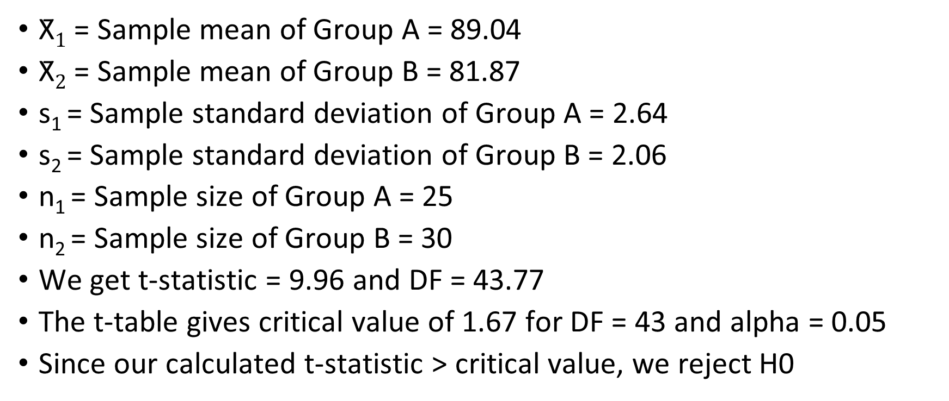
Example
$\text{X}\text{̄}1$ = Sample mean of Group A = 89.04
$\text{X}\text{̄}2$ = Sample mean of Group B = 81.87
s₁ = Sample standard deviation of Group A = 2.64
s₂ = Sample standard deviation of Group B = 2.06
n₁ = Sample size of Group A = 25
n₂ = Sample size of Group B = 30
We get t-statistic = 9.96 and DF = 43.77
The t-table gives critical value of 1.67 for DF = 43 and alpha = 0.05
Since our calculated t-statistic > critical value, we reject H0

Slide 16
Code
C:\code\Data Analytics\two-sample-t-test.py

Slide 17
Independent Sample T-Test
Example: Test whether there is significant price difference between women shoes of pink color and other colors
Python example: C:\code\Data Analytics\ t_test_independent.py
QQ Plot explanation: Next slide

Slide 18
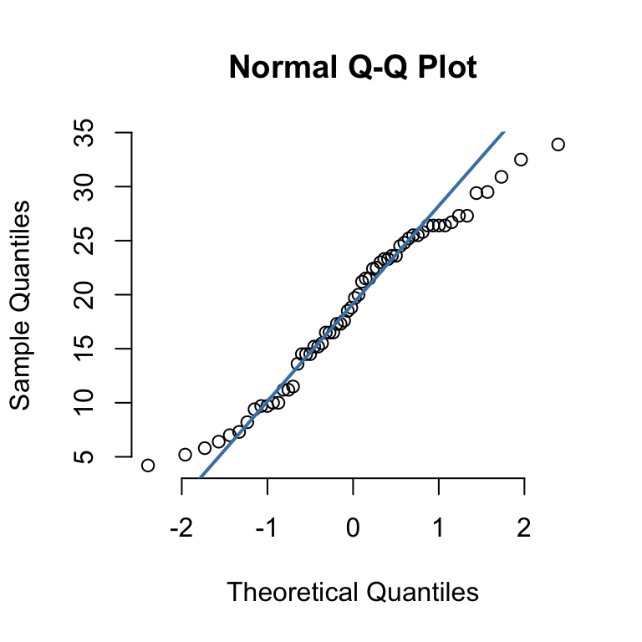
QQ Plot
Quantile-Quantile Plot (QQ Plot) is used to check if a dataset follows some specific theoretical distribution, e.g. normal distribution
Note: Quantiles are values that divide a dataset into intervals of equal probability or percentiles - They help you understand the distribution of data by splitting it into specific parts (e.g. median will split data into two parts)
It compares the quantiles of your data against the quantiles of a chosen theoretical distribution
If the points on the QQ plot fall approximately along a straight line, it suggests that the data follows the chosen theoretical distribution

Slide 19
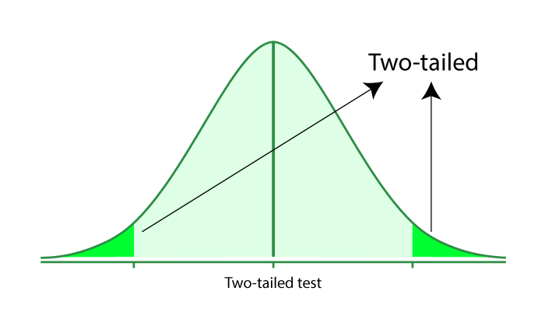
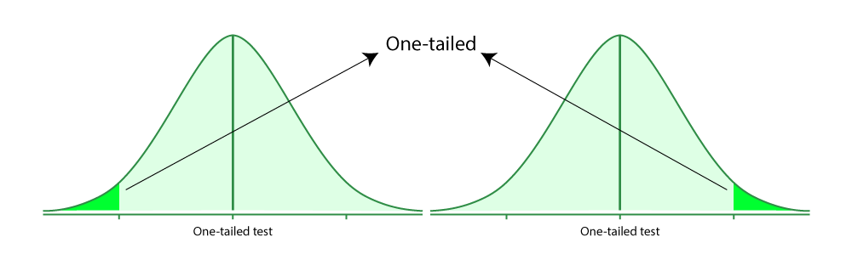
Two-Tailed and One-Tailed Tests

Slide 20
Two-Tailed and One-Tailed Tests
Two-tailed Test
H₀: The average weight of chips in a packet is equal to 50 grams (μ = 50)
Ha: The average weight of chips in a packet is not equal to 50 grams (μ ≠ 50)
Rejection zone: Both to the left and to the right of 50
One-Tailed Test (Left-Tailed)
H₀: The average weight of chips in a packet is equal to or greater than 50 grams (μ ≥ 50)
Ha: The average weight of chips in a packet is less than 50 grams (μ < 50)
Rejection zone: Towards the left side of 50
One-Tailed Test (Right-Tailed):
H₀: The average weight of chips in a packet is equal to or less than 50 grams (μ ≤ 50)
Ha: The average weight of chips in a packet is greater than 50 grams (μ > 50)
Rejection zone: Towards the right side of 50

Slide 21
Impact on α
When we use two-tailed tests, generally α = 0.05
But in a one-tailed test, α = 0.05 / 2 = 0.025

Slide 22
One-way ANOVA

Slide 23
Analysis of Variance (ANOVA)
Analysis of Variance (ANOVA) is a statistical technique used to analyze whether there are statistically significant differences among the means of three or more groups
H0 = All group means are equal, Ha = At least one group mean is different
Uses F-statistic; higher its value, higher the difference in means
Also if p-value < 0.05, we can reject the null hypothesis

Slide 24
ANOVA Example
Test scores of students:
Teaching Method A: [85, 88, 91, 78, 82]
Teaching Method B: [75, 79, 80, 82, 78]
Teaching Method C: [90, 85, 88, 92, 87]
H0: There are no significant differences in the mean test scores among the three teaching methods
Ha: At least one teaching method has a different mean test score than the others
Mean of Method A: (85 + 88 + 91 + 78 + 82) / 5 = 84.8
Mean of Method B: (75 + 79 + 80 + 82 + 78) / 5 = 78.8
Mean of Method C: (90 + 85 + 88 + 92 + 87) / 5 = 88.4
Grand Mean: (84.8 + 78.8 + 88.4) / 3 = 84

Slide 25
ANOVA Example
SST = Sum of Squares Treatment, measures the variability of group means
SST = Σ (Nt * (Mean of Group t - Grand Mean)^2)
SST = (5 * (84.8 - 84)^2) + (5 * (78.8 - 84)^2) + (5 * (88.4 - 84)^2)
SST ≈ 133.2
SSE = Sum of Squares Error, measures the variability in the groups
SSE = Σ Σ (Xi - Mean of Group i)^2
SSE = (85-84.8)^2 + (88-84.8)^2 + (91-84.8)^2 + (78-78.8)^2 + (82-78.8)^2 + (75-78.8)^2 + (79-78.8)^2 + (80-78.8)^2 + (82-78.8)^2 + (78-78.8)^2 + (90-88.4)^2 + (85-88.4)^2 + (88-88.4)^2 + (92-88.4)^2 + (87-88.4)^2
SSE ≈ 50.8

Slide 26
ANOVA Example
F = (SST / (k - 1)) / (SSE / (N - k))
Where k is the number of groups (3 in this case) and N is the total number of observations (15).
F = (133.2 / 2) / (50.8 / 12)
F ≈ 8.88
Now go to F-table (https://users.sussex.ac.uk/~grahamh/RM1web/F-ratio%20table%202005.pdf), go to column 2, row 12 (See next slide)
Since calculated F-value (8.88) > critical statistic (3.89), we reject the null hypothesis

Slide 27
ANOVA Example: Why column 2, row 14?
Total Degrees of Freedom (df_total): This represents the total number of observations minus 1 = 15 - 1 = 14
Between-Groups Degrees of Freedom (df_between): This corresponds to the number of groups minus 1 = 3 - 1 = 2
Within-Groups Degrees of Freedom (df_within): This is calculated by subtracting df_between from df_total 14 - 2 = 12
We need to go to df_between column and df_within row, hence column 2 and row 12

Slide 28
ANOVA Python Examples
C:\code\Data Analytics\anova.py
C:\code\Data Analytics\anova_student_performance.py

Slide 29
Chi Square Test

Slide 30
Chi-Square Test
Chi-square test is used to analyze categorical data
Comes in two types
Chi-square test for goodness of fit: Are observed frequencies as expected?
Chi-square test for independence: Do we find a significant association between two categorical variables?

Slide 31
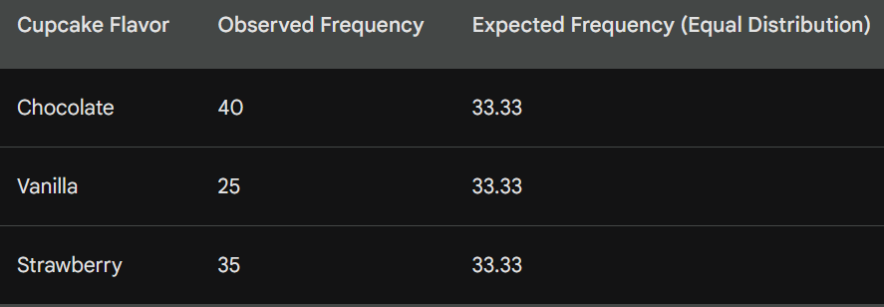
Chi-square test for goodness of fit
Checks if the observed frequencies of a single categorical variable match with a pre-defined expected distribution
Example: A bakery wants to see if their customers prefer chocolate, vanilla, or strawberry cupcakes equally. They record sales for a week.
H0: All flavors have equal preferences

Slide 32
Chi-square test for goodness of fit
Calculate (O - E)^2: Subtract the expected values (33.33) from each observed value (40, 25, 35) to get three squared differences: (40 - 33.33)^2, (25 - 33.33)^2, and (35 - 33.33)^2: Result is 44.89, 72.99, and 3.24, respectively
Divide by expected values: Divide each squared difference from step 1 by its corresponding expected value (33.33): Result 1.35, 2.19, and 0.098
Sum the results: Add these three values (1.35 + 2.19 + 0.098) to get the chi-square statistic of 3.5003, Critical value: 5.991
P-value = 0.1737, which is > 0.05, so we do not reject H0

Slide 33
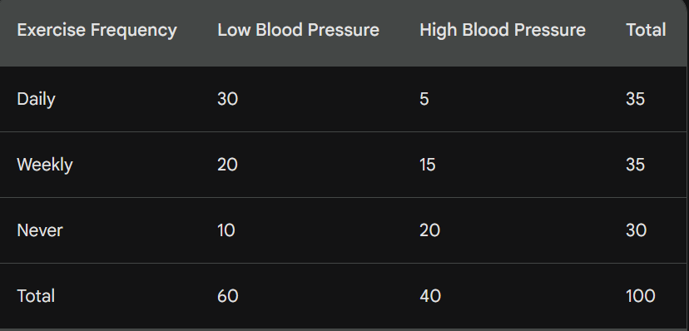
Chi-square test for independence
This test investigates whether there is a significant association between two categorical variables
A healthcare provider wants to know if there is a relationship between exercise frequency and blood pressure levels

Slide 34
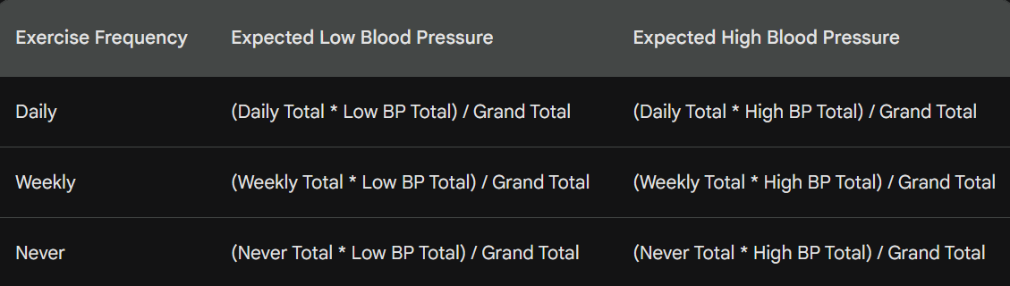
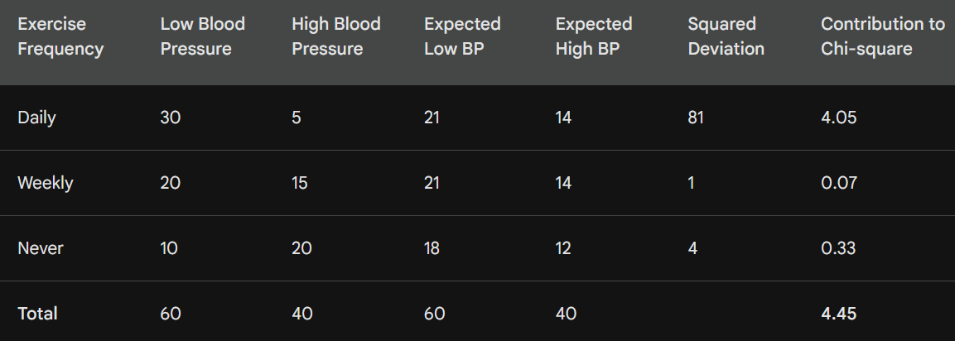
Chi-square test for independence
Calculate expected frequencies

Slide 35
Chi-square test for independence
Result
Chi-square statistic: 4.45
Degrees of freedom: 2
p-value: approximately 0.107 (using chi-square distribution table)
Conclusion: Fail to reject H0

Slide 36
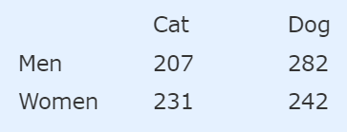
Chi-square Test for independence – Step by Step
Does gender affect which pet is liked more, for the following data?
Solution: First define Hypotheses
H0: Gender and preference for cats or dogs are independent
H1: Gender and preference for cats or dogs are not independent

Slide 37
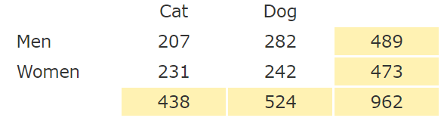
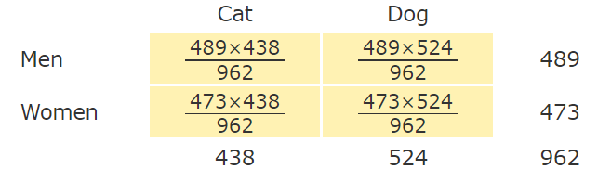
Chi-square Test for independence – Step by Step
Add up all the row and column values
Calculate “Expected value” for each cell by multiplying each row total by each column total and dividing it by the overall total
The estimated value for each cell is the total for its row multiplied by the total for its column, then divided by the total for the table: that is, (RowTotal*ColTotal)/GridTotal.

Slide 38
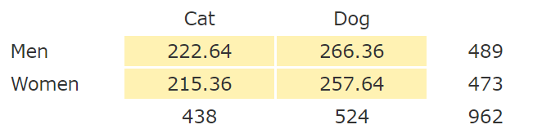
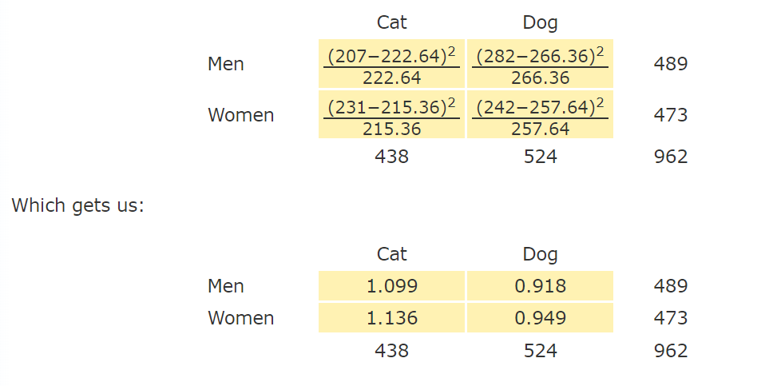
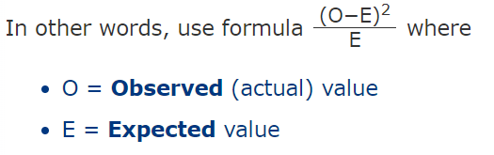
Chi-square Test for independence – Step by Step
Resulting “Expected values” table
Subtract expected from observed, square it, and divide by expected

Slide 39
Chi-square Test for independence – Step by Step
A significance (alpha) level of 0.05 indicates a 5% risk of concluding that an association between the variables exists when there is no actual association.
Now add up the calculated values
1.099 + 0.918 + 1.136 + 0.949 = 4.102
Chi-Square is 4.102
Now calculate Degrees of freedom = (row count – 1) x (column count – 1) = (2 – 1) x (2 – 1) = 1
Look up in the Chi-square table (https://people.richland.edu/james/lecture/m170/tbl-chi.html) for DF = 1 and alpha level of 0.05. The value (called as critical value) is 3.841, which is less than our Chi-square value.
Conclusion: Observed value (i.e. our Calculated value) > Critical value (i.e. the Chi-square Table value), so we reject the null hypothesis.

Slide 40
Chi-Square Python Functions: stats.chisquare
stat.schisquare()
Used for Chi-square test for goodness of fit
Compares observed frequencies with expected frequencies
chi2_contingency()
Used for conducting a chi-square test of independence or association between two categorical

Slide 41
Chi-Square Code Examples
C:\code\Data Analytics\chi_square_goodness_of_fit.py
C:\code\Data Analytics\ chi_square_independence.py

Slide 42
Null Hypothesis – How to State?
Test | Null Hypothesis
One-sample T-Test | There is no significant difference between the sample mean and the hypothesized population mean
Two-sample T-Test | The population means of the two groups are equal
Chi-Square Test | There is no association between the two categorical variables (they are independent)
ANOVA | The means of multiple groups are equal
Linear regression | The coefficients of the independent variables are equal to zero (no relationship)
Logistic regression | There is no association between the independent variables and the binary outcome

Slide 43
Skewness

Slide 44
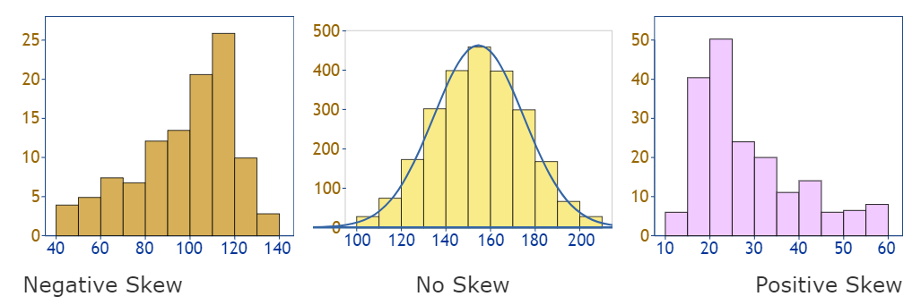
Skewness
Data can be skewed, meaning it tends to have a long tail on one side or the other:

Slide 45
Skewness and Measures of Central Tendency
Data skewness | Sequence
No skew | None (Mean = Mode = Median)
Negative skew (Left skew) | Mean-Median-Mode
Positive skew (Right skew) | Mode-Median-Mean

Slide 46
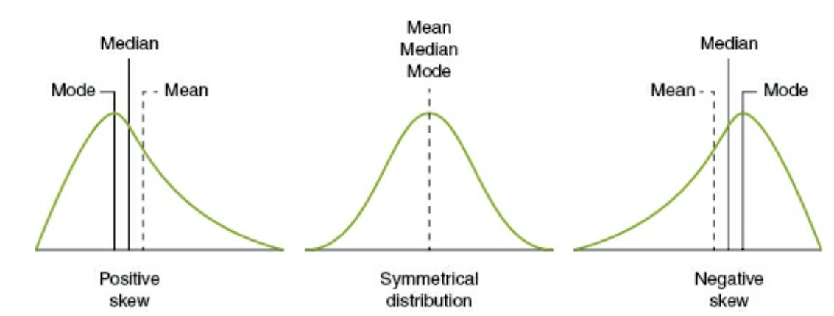
Skewness and the Measures of Central Tendency

Slide 47
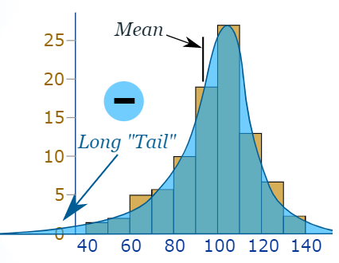
Negative Skew
Why is it called negative skew? Because the long "tail" is on the negative side of the peak.
Some people say it is "skewed to the left" (the long tail is on the left hand side)
The mean is also on the left of the peak.

Slide 48
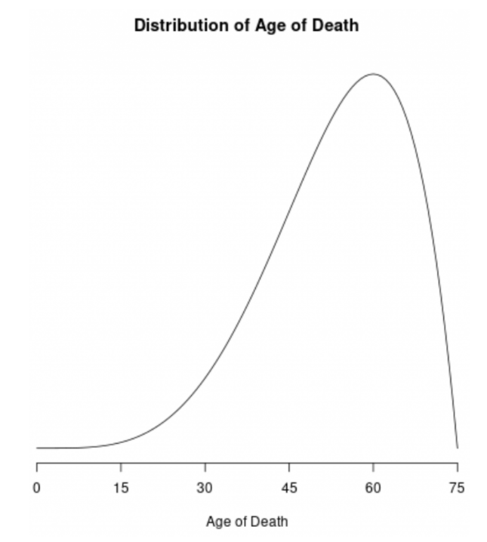
Negative Skew Example
The distribution of the age of deaths in most populations is negatively skewed
Most people live to be between 70 and 80 years old, with fewer and fewer living less than this age

Slide 49
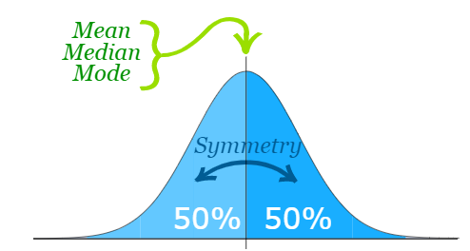
Normal Distribution: No Skew
A Normal Distribution is not skewed. It is perfectly symmetrical.
Mean is exactly at the peak.

Slide 50
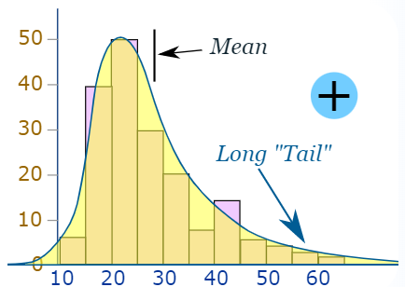
Positive Skew
Positive skew is when the long tail is on the positive side of the peak
Some people say it is "skewed to the right".
The mean is on the right of the peak value.

Slide 51
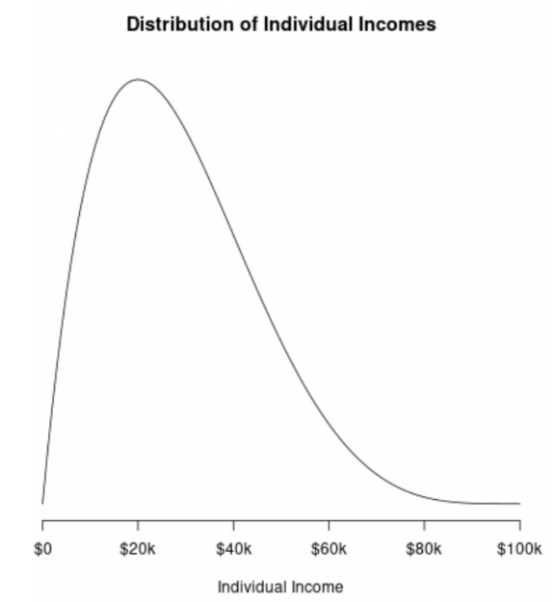
Positive Skew Example
The distribution of individual incomes in the U.S. is right-skewed, with most individuals earning between $20k and $40k per year
It has a long right tail of households that earn much more

Slide 52
Skewness Formulae
Many formulae exist:
Pearson's First Coefficient of Skewness (Mode Skewness): (Mean - Median) / Standard Deviation
Another variation: 3 (Mean - Median) / Standard Deviation
Fisher-Pearson Coefficient of Skewness (Moment Skewness): (Σ(xi - Mean)^3 / n) / [(Σ(xi - Mean)^2 / n)^(3/2)]
Quantile-Based Skewness: (Q3 + Q1 - 2 * Median) / (Q3 - Q1)

Slide 53
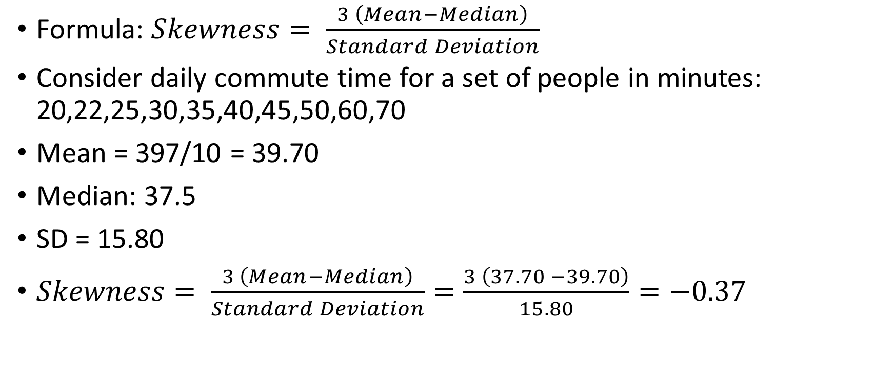
Pearson’s Coefficient of Skewness
Formula: $Skewness= \frac{3 \left(Mean−Median\right)}{Standard Deviation}$
Consider daily commute time for a set of people in minutes: 20,22,25,30,35,40,45,50,60,70
Mean = 397/10 = 39.70
Median: 37.5
SD = 15.80
$Skewness= \frac{3 \left(Mean−Median\right)}{Standard Deviation}=\frac{3 \left(37.70 −39.70\right)}{15.80}=−0.37$

Slide 54
Interpretation
Skewness = 0: No skewness
Large negative skewness: Distribution is negatively skewed (Data is skewed to the left), Most of the data is towards the left
Large positive skewness: Distribution is positively skewed (Data is skewed to the right), Most of the data is towards the right
Conclusion: In our case, skewness was -0.37; meaning that most of the commute times are less than the mean commute time (See next slide)

Slide 55
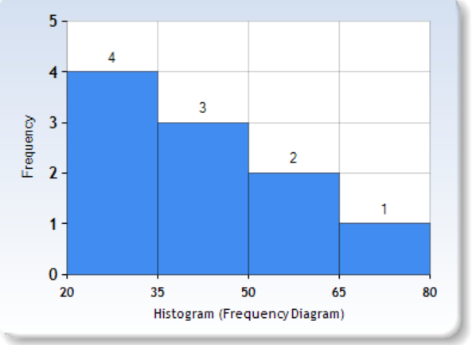
Visual interpretation of our Negative Skew

Slide 56
Kurtosis

Slide 57
Kurtosis
Kurtosis is a statistical measure that describes the shape of the probability distribution of a real-valued random variable
Indicates whether the tails of a distribution are heavy or light compared to a normal distribution

Slide 58
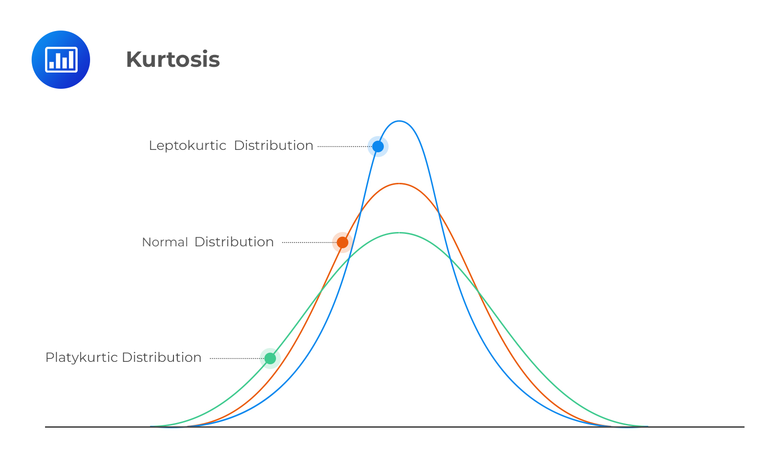
Kurtosis

Slide 59
Kurtosis Interpretation
Leptokurtic (Positive Kurtosis)
Heavy tails and a sharp peak
Kurtosis values higher than 3
Data has more outliers or extreme values than a normal distribution
Mesokurtic (Normal Kurtosis)
A distribution with the same kurtosis as a normal distribution (kurtosis = 3)
Tails and peak are similar to a normal distribution
Platykurtic (Negative Kurtosis)
A distribution with lighter tails and a flatter peak than a normal distribution
Kurtosis values lower than 3
Data has fewer outliers than a normal distribution

